Slide 1
Error Detection and Correction

Slide 2
Types of Errors
In digital communication systems an error occurs when a bit is altered between transmission and reception.
i.e . A binary 1 is transmitted and a binary 0 is received or a binary 0 is transmitted and a binary 1 is received.

Slide 3
Basic concepts
Networks must be able to transfer data from one device to another with complete accuracy.
Data can be corrupted during transmission.
For reliable communication, errors must be detected and corrected.
Error detection and correction are implemented either at the data link layer or the transport layer of the OSI model.

Slide 4
Types of Errors
Errors
Burst errors
Single-bit errors

Slide 5
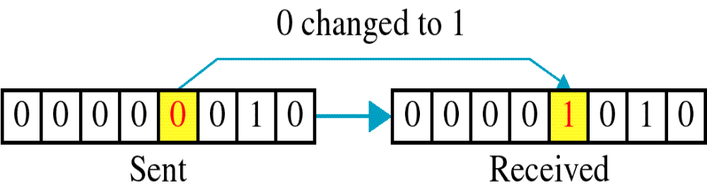
Single-bit error
An isolated error condition that alters one bit but does not affect nearby bits.
Caused by white noise

Slide 6
Single bit errors are the least likely type of errors in serial data transmission because the noise must have a very short duration which is very rare. However this kind of errors can happen in parallel transmission.
Example:
If data is sent at 1Mbps then each bit lasts only 1/1,000,000 sec. or 1 μs.
For a single-bit error to occur, the noise must have a duration of only 1 μs, which is very rare.

Slide 7
Burst error
A burst error of length B is a contiguous sequence of B bits in which the first and last bits and any number of intermediate bits are received in error.
It is caused by impulse noise.
Error burst:Definition
  A group of bits in which two successive erroneous bits are always separated by less than a given number x of correct bits.
  The last erroneous bit in the burst and the first erroneous bit in the following burst are accordingly separated by x correct bits or more.
  The effect of burst errors are greater at higher data rate.

Slide 8
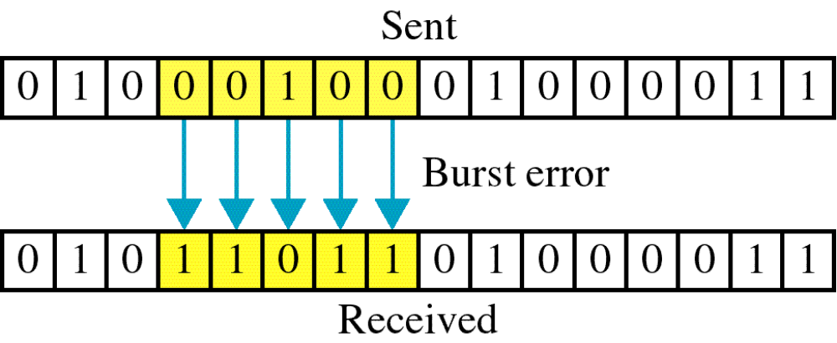
Burst error

Slide 9
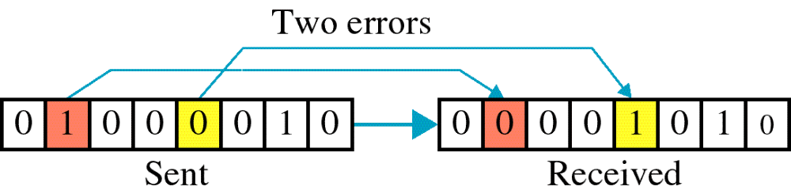
Burst error

Slide 10
The term burst error means that two or more bits in the data unit have changed from 1 to 0 or from 0 to 1.
Burst errors does not necessarily mean that the errors occur in consecutive bits, the length of the burst is measured from the first corrupted bit to the last corrupted bit. Some bits in between may not have been corrupted.

Slide 11
Burst error is most likely to happen in serial transmission since the duration of noise is normally longer than the duration of a bit.
The number of bits affected depends on the data rate and duration of noise.
Example:
If data is sent at rate = 1Kbps then a noise of 1/100 sec can affect 10 bits.(1/100*1000)
If same data is sent at rate = 1Mbps then a noise of 1/100 sec can affect 10,000 bits.(1/100*10⁶)

Slide 12
Error Detection
In digital transmission systems ,data are transmitted as one or more contiguous sequences of bits, called frames
Some probabilities with respect to errors are defined:
    P_{b} : Probability that a single bit is received in error (also called BER)
    P₁ : Probability that a frame arrives with no bit errors
    P₂ : While using error detection algorithm in use, the probability that a frame arrives with one or more undetected errors
    P₃ : While using error detection algorithm, the probability that a frame arrives with one or more detected bit errors but no undetected bit errors
    (also called residual error rate)

Slide 13
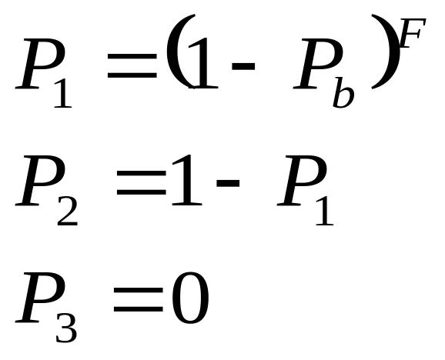
Error Detection Probabilities
If there is no error detection algorithm used then the probability that any bit is in error (P₃₎ is zero.
Assume the probability that any bit is in error (P_{b)} is constant and independent for each bit.
Then,
    F = Number of bits per frame

Slide 14
Error Detection Probabilities
The probability that a frame arrives with no bit errors decreases when the probability of a single bit error increases.
Also, the probability that a frame arrives with no bit errors decreases with increasing frame length.
The longer the frame ,the more bits it has and the higher probability that one of these is in error.

Slide 15
Error detection
Error detection means to decide whether the received data is correct or not without having a copy of the original message.
Error detection uses the concept of redundancy, which means adding extra bits for detecting errors at the destination.
Notes:
Make sense of message.
Make sense of message.

Slide 16
Error detection process
All error detection techniques operate on the following principle:
  For a given frame of bits ,additional bits that constitute an error-detecting code are added by the transmitter.
  The code is calculated as a function of other bits.
  For a data block of k-bits ,the error detecting algorithm yields an error –detecting code of n-k bits ,where (n-k)<k
  The error detecting code is referred as check bits.
  The check bits are appended to the data block to produce a frame of n-bits ,which is then transmitted.

Slide 17
Error detection process
  The receiver separates the incoming frame into the k-bits of data and (n-k) bits of error detecting code.
  The receiver performs the same error detecting calculation on the data bits and compares this value with the value of the incoming error-detecting code.
  A detected error occurs if and only if there is a mismatch.
  The error detection process is shown in fig.

Slide 18
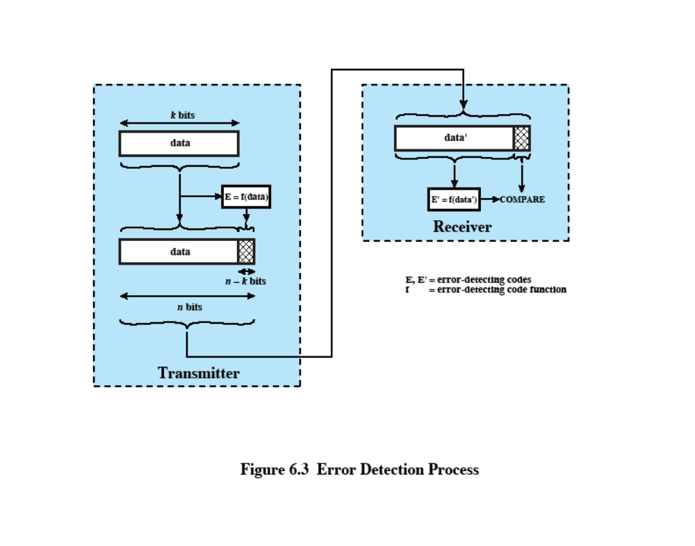
Error Detection Process
Notes:
Stallings DCC8e figure 6.3 illustrates the error detection process. For a given frame of bits, additional bits that constitute an error-detecting code are added by the transmitter. This code is calculated as a function of the other transmitted bits. Typically, for a data block of k bits, the error-detecting algorithm yields an error-detecting code of n – k bits, where (n – k) < k. The error-detecting code, also referred to as the check bits, is appended to the data block to produce a frame of n bits, which is then transmitted. The receiver separates the incoming frame into the k bits of data and (n – k) bits of the error-detecting code. The receiver performs the same error-detecting calculation on the data bits and compares this value with the value of the incoming error-detecting code. A detected error occurs if and only if there is a mismatch.

Slide 19
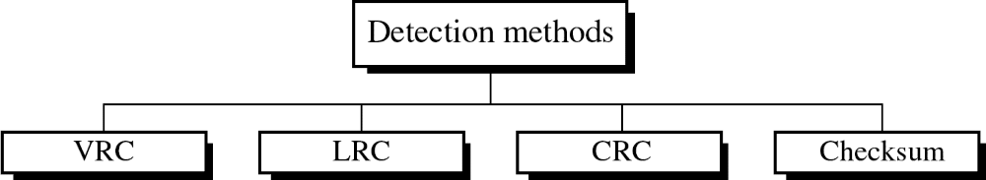
Four types of redundancy checks are used
in data communications

Slide 20
Parity Check
Is the simplest error-detecting scheme.
A parity bit is appended to the end of block of data .
E.g in character transmission ,a parity bit is attached to each 7-bit IRA character.
The value of this bit is selected so that the character has an even number of 1’s (even parity) or an odd number of 1’s(odd parity)
E.g G=1110001
If odd parity,append 1 and transmit 11110001

Slide 21
Parity Check
At the receiver examining the character if the total number of 1s is odd ,assume no error has occurred.
If one bit or any odd number of bits is erroneously inverted during transmission ,then the receiver will detect an error.
It two or even number of bits are inverted due to error ,an undetected error occurs.
Even parity used for synchronous transmission and odd parity is used for asynchronous transmission.

Slide 22
Performance
It can detect single bit error
It can detect burst errors only if the total number of errors is odd.

Slide 23
Two dimensional parity check or Longitudinal
Redundancy Check(LRC)
Performance can be improved by using two-dimensional parity check, which organizes the block of bits in the form of a table.
Parity check bits are calculated for each row which is euivalent to a simple parity check bit
Parity check bits are also calculated for all columns
Both are sent along with the data
At the receiving end these are compared with the parity bits calculated on the received data

Slide 24
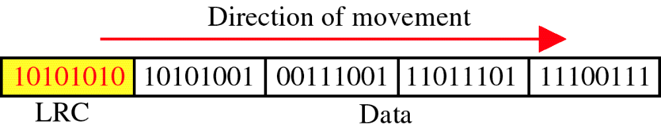
Two dimensional parity check orLongitudinal
Redundancy Check(LRC)

Slide 25
Longitudinal Redundancy Check(LRC)
e.g if original data is:
  10110011:10101011:01011010:11010101

Slide 26

Figure 10.11 Two-dimensional parity-check code
10.<number>

Slide 27
Longitudinal Redundancy Check(LRC)
Data to be sent:
101100111:101010111:010110100:110101011:100101111
Overhead is more than simple parity
Detect many burst errors,but not all
10.<number>

Slide 28

Figure 10.11 Two-dimensional parity-check code
10.<number>

Slide 29

Figure 10.11 Two-dimensional parity-check code
10.<number>

Slide 30
Performance
LCR increases the likelihood of detecting burst errors.
If two bits in one data units are damaged and two bits in exactly the same positions in another data unit are also damaged, the LRC checker will not detect an error.

Slide 31
Cyclic Redundancy Check
CRC
Most common and powerful technique
Given a k-bit block of bits or message ,the transmitter generates an (n-k) bit sequence, known as frame check sequence such that the resulting frame ,consisting of n-bits is exactly divisible by some predetermined number .
The receiver then divides the incoming frame by that number and if there is no remainder ,assumes there was no error.
There are different ways for finding the CRC.

Slide 32
Cyclic Redundancy Check (CRC)
Transmitter
  For a k-bit block, transmitter generates an (n-k)-bit frame check sequence (FCS)
  Resulting frame of n bits is exactly divisible by predetermined number
Receiver
  Divides incoming frame by predetermined number
  If no remainder, assumes no error

Slide 33
Cyclic Redundancy Check
CRC
The procedure for CRC can be done in 3 ways:
    Modulo 2 Arithmetic
    Polynomial
    Digital Logic

Slide 34
CRC using Modulo 2 Arithmetic
Modulo 2 Arithmetic uses binary addition with no carries which is just Exclusive-OR (XOR) operation
Parameters:
    T = n-bit frame to be transmitted
    D = k-bit block of data; the first k bits of T
    F = (n – k)-bit FCS; the last (n – k) bits of T
    P = pattern of n–k+1 bits; this is the predetermined divisor
    Q = Quotient
    R = Remainder

Slide 35
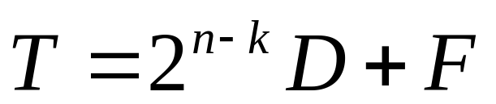
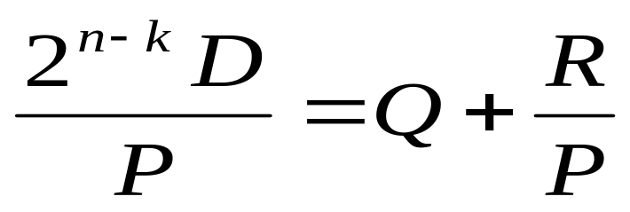
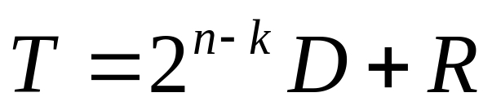
CRC using Modulo 2 Arithmetic
For T/P to have no remainder, start with
Divide 2^{n-k}D by P gives quotient and remainder
Use remainder as FCS(which will be one bit shorter than divisor)

Slide 36
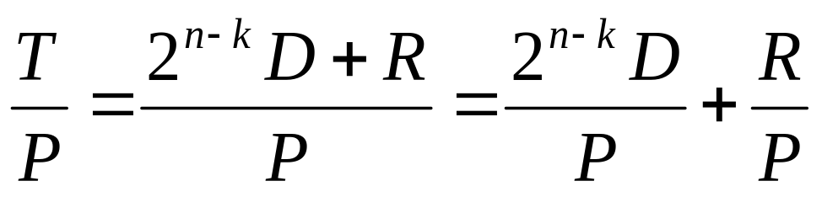
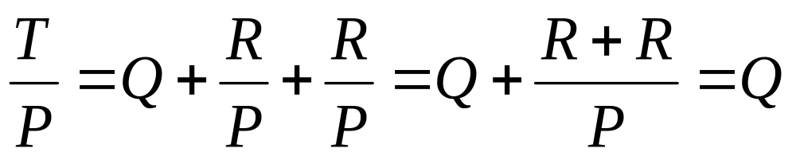
CRC using Modulo 2 Arithmetic
Does R cause T/P have no remainder?
Substituting,
  No remainder, so T is exactly divisible by P

Slide 37
Modulo 2 Arithmetic
Addition Rules
0 + 0 = 0 Ex: 1011
0 + 1 = 1 +110
1 + 0 = 1 1101
1 + 1 = 0
For e.g.
  1 1 1 1 1 1 1 1
  + 1 0 1 0 _ 0 1 0 1
  0 1 0 1 1 0 1 0

Slide 38
Modulo 2 Arithmetic
Division
________
Ex: 1011 | 1001011
^ ^
divisor dividend

Slide 39
Modulo 2 Arithmetic
Division
____1___
Ex: 1011 | 1001011
1011
Ch 2.7 > Cyclic Redundancy Check > Modulo 2 Arithmetic

Slide 40
Modulo 2 Arithmetic
Division
____1___
Ex: 1011 | 1001011
1011
0010
Ch 2.7 > Cyclic Redundancy Check > Modulo 2 Arithmetic

Slide 41
Modulo 2 Arithmetic
Division
____10__
Ex: 1011 | 1001011
1011
00100

Slide 42
Modulo 2 Arithmetic
Division
____101_
Ex: 1011 | 1001011
1011
001001
Ch 2.7 > Cyclic Redundancy Check > Modulo 2 Arithmetic

Slide 43
Modulo 2 Arithmetic
Division
____101_
Ex: 1011 | 1001011
1011
001001
1011
Ch 2.7 > Cyclic Redundancy Check > Modulo 2 Arithmetic

Slide 44
Modulo 2 Arithmetic
Division
____101_
Ex: 1011 | 1001011
1011
001001
1011
0010

Slide 45
Modulo 2 Arithmetic
Division
____1010
Ex: 1011 | 1001011
1011
001001
1011
00101

Slide 46
Modulo 2 Arithmetic
Division
____1010 ← Quotient
Ex: 1011 | 1001011
1011
001001
1011
00101 ← Remainder

Slide 47
Example
Let the information byte D = 1001011
The sender and receiver agree on an arbitrary binary pattern P. Let P = 1011.
Shift D to the left by 1 less than the number of bits in P. Now, T = 1001011000.
Let T be the dividend and P be the divisor. Perform “modulo 2 division”.
After performing the division, we ignore the quotient. We got 100 for the remainder, which becomes the actual CRC checksum.
Add(concatenate) the remainder to D, giving the message T:
1001011 + 100 = 1001011100 = M

Slide 48
Calculating and Using CRCs
T is decoded and checked by the message receiver using the reverse process.
____1010100
1011 | 1001011100
1011
001001
1001
0010
001011
1011
0000 ← Remainder

Slide 49
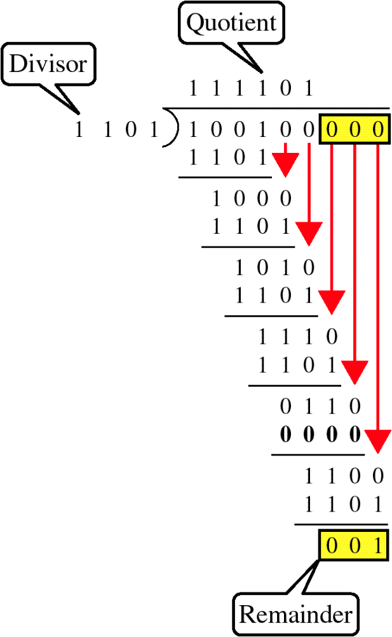

Example
D=100100
P=1101
R=001
Transmitted block:100100001

Slide 50
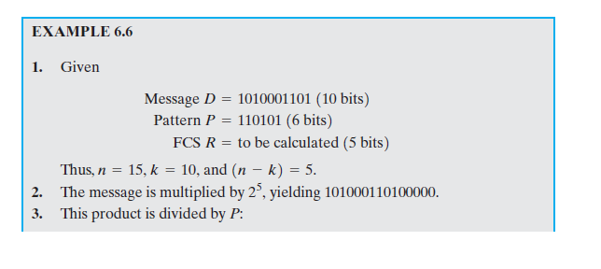
Example

Slide 51
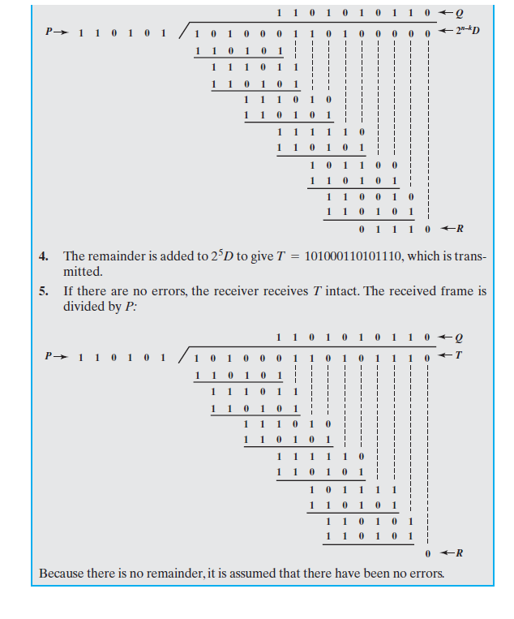

Slide 52
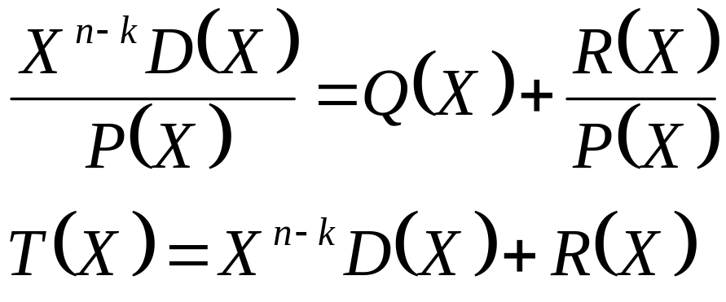
CRC using Polynomials
All values expressed as polynomials of Dummy variable X with binary coefficients
The coefficients corresponds to the bits in the binary number

Slide 53
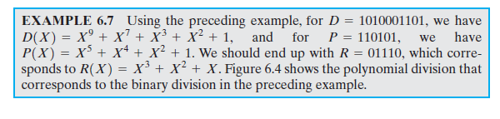
Example

Slide 54
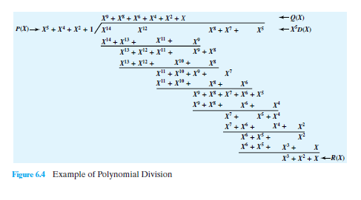

Slide 55
CRC
An error E(X) will only be undetectable if it is divisible by P(X)
The following errors are not divisible by a suitably chosen P(X) and hence are detectable
  All single bit errors ,if P(X) has more than one non zero term
  All double bit errors ,as long as P(X) has a factor with three terms
  Any odd number of errors ,as long as P(X) contains a factor(x+1)
  Any burst error for which the length of the burst is less than or equal to length of the FCS

Slide 56
CRC using Polynomials
Widely used versions of P(X)
  CRC–12
    X¹² + X¹¹ + X³ + X² + X + 1
  CRC–16
    X¹⁶ + X¹⁵ + X² + 1
  CRC – CCITT
    X¹⁶ + X¹² + X⁵ + 1
  CRC – 32
    X³² + X²⁶ + X²³ + X²² + X¹⁶ + X¹² + X¹¹ + X¹⁰ + X⁸ + X⁷ + X⁵ + X⁴ + X² + X + 1

Slide 57
CRC using Polynomials
CRC-12 system is used for transmission of streams of 6-bit characters and generates 12-bit FCS
CRC-16 & CRC-CCITT are popular for 8-bit characters (in US&Europe),both result in 16-bit FCS
CRC-32 is used in IEEE 802 LAN standards

Slide 58
CRC using Digital Logic
Dividing circuit consisting of:
  XOR gates
    Up to n – k XOR gates
    Presence of a gate corresponds to the presence of a term in the divisor polynomial P(X)
  A shift register
    String of 1-bit storage devices
    Register contains n – k bits, equal to the length of the FCS

Slide 59
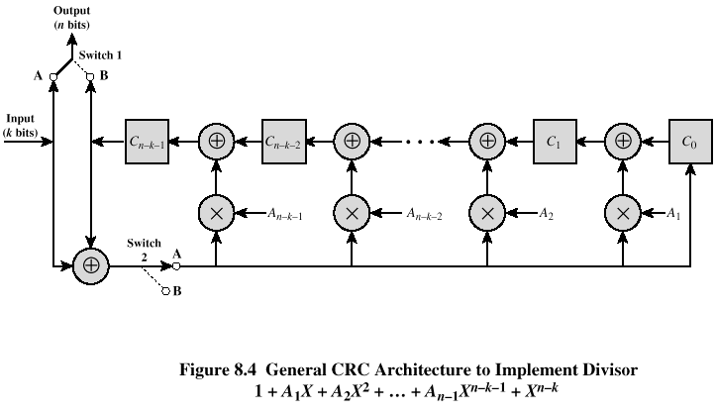
CRC using Digital Logic
Wireless Networks Spring 2005

Slide 60
Example
Consider Data D=1010001101
Divisor P=110101
    D(X)=X⁹ + X⁷ + X³ + X² + 1
    P(X)=X⁵ + X⁴ + X² + 1
Fig shows the shift register implementation

Slide 61
CRC using Digital Logic
Sender
  The process begins with the shift register cleared(all zeros)
  The message or dividend is then entered one bit at a time ,starting with most significant bit.
  Fig. shows the step-by-step operation as the input is applied one bit at a time.
  The row of the table shows the values currently stored in the five shift register elements
  In addition ,the row shows the values that appear at the outputs of the three XOR circuits
  Finally ,the row shows the value of the next input bit ,which is available for the operation of the next step.
  The XOR operation affects only C0,C2 and C4 on the next shift.
  The process continues through all the bits of the message
  To produce the proper output ,two switches are used
  The input data bits are fed in with both switches in the A position.

Slide 62
CRC using Digital Logic
  As a result, for the first 10 steps ,the input bits are fed into the shift register and also used as output bits.
  After the last data is processed ,the shift register contains the remainder(FCS)
  As soon as the last data is provided to the shift register ,both switches are set to B position.
  This has two effects
    All of the XOR gates become simple pass throughs ,no bits are changed
    As the shifting process continues,the 5 CRC bits are output.

Slide 63
CRC using Digital Logic
Receiver
  At the receiver ,the same logic is used
  As each bit of M arrives, it is inserted into the shift register
  If there have been no errors ,the shift register should contain the bit pattern for R at the conclusion of M
  The transmitted bits of R now begin to arrive and the effect is to zero out the register so that,at the conclusion of reception, the register contains all zeros.

Slide 64
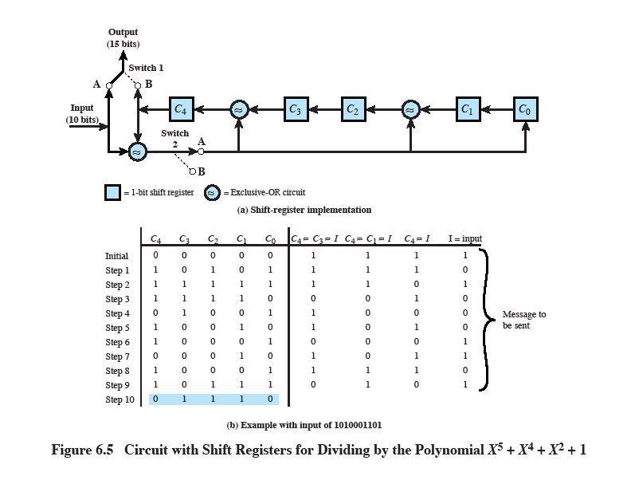

Slide 65
Error Correction
It can be handled in two ways:
receiver can have the sender retransmit the entire data unit(backward error correction).
The receiver can use an error-correcting code, which automatically corrects certain errors(forward error correction).

Slide 66
Single-bit error correction
To correct an error, the receiver reverses the value of the altered bit. To do so, it must know which bit is in error.
Number of redundancy bits needed
Let data bits = m
Redundancy bits = r
∴Total message sent = m+r
The value of r must satisfy the following relation:
2^{r} ≥ m+r+1

Slide 67
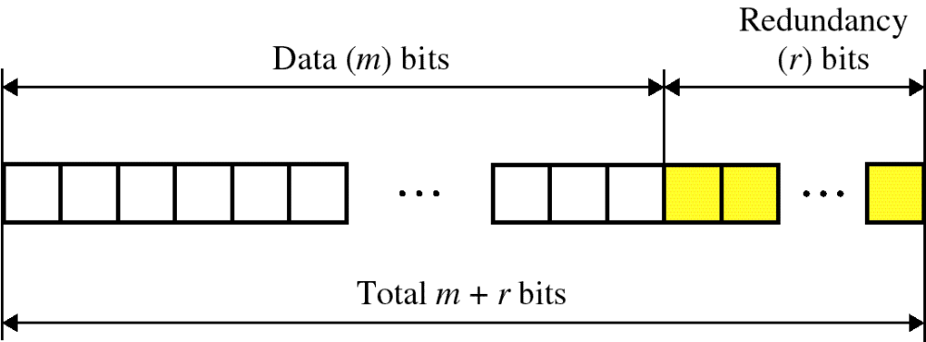
Error Correction

Slide 68
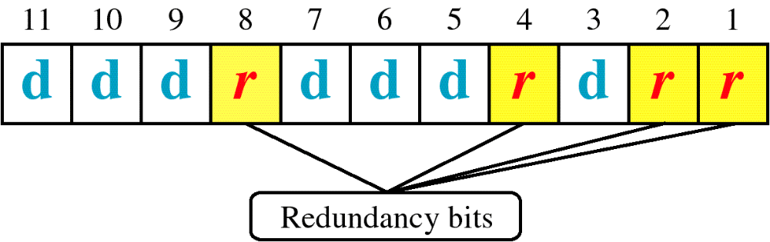
Hamming Code

Slide 69
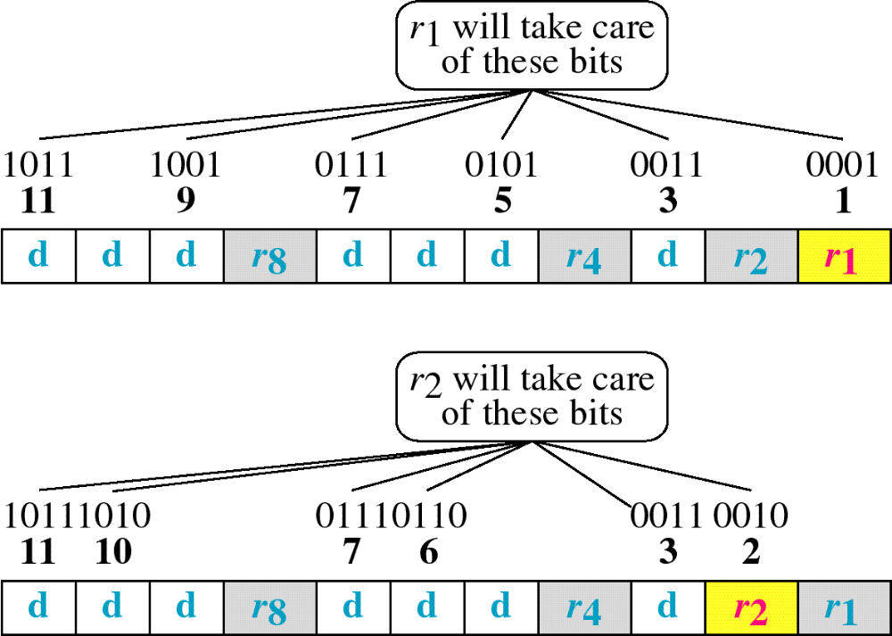
Hamming Code

Slide 70
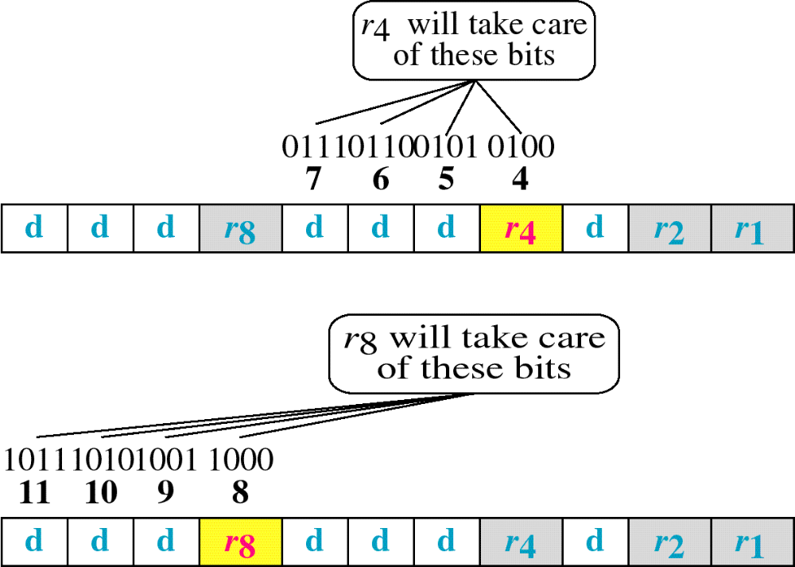
Hamming Code

Slide 71
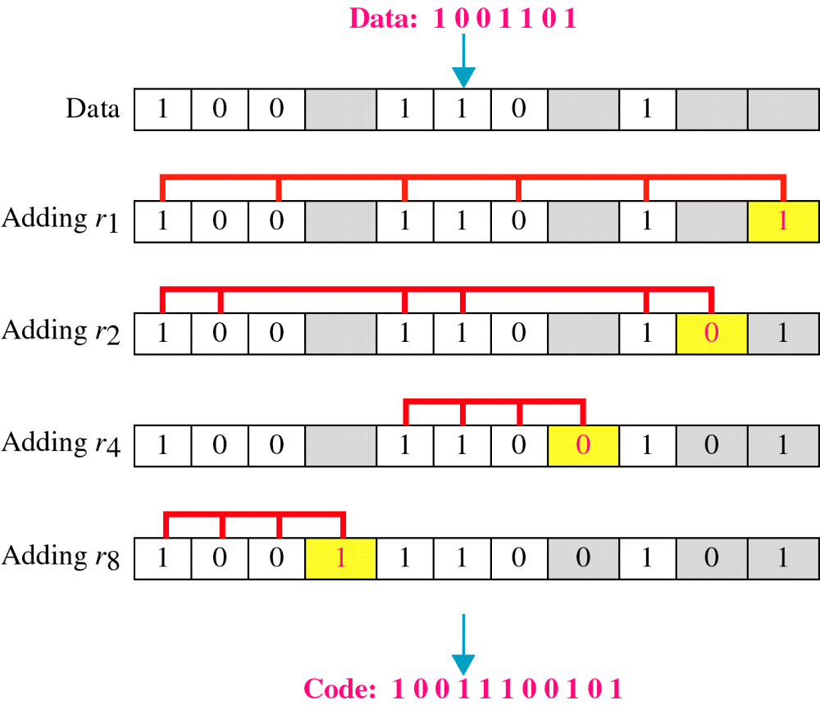
Example of Hamming Code

Slide 72
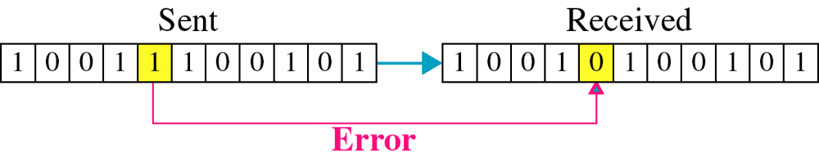
Single-bit error

Slide 73

Error
Detection

